Slide 1

DEPARTMENT OF COMPUTER ENGINEERING
Radiant Games - Online Games Store (SE-A-17)
Students name:
Pranil Belge(11)
Aaryan Chothani(20)
Dipesh Jaiswar(54)
Suyash Kannaujiya(59)
Under the Guidance of: Prof. Vandana Virbhadre

Slide 2
Problem statement
All video games are available at different websites online. Hence, it is very difficult to find and purchase games at the cheapest price possible at one location.
Objectives
To solve the problem of unavailability of video games at one place and let users buy games at an optimal price and hence solve the problem of having to visit multiple locations just to buy a video game.
Radiant Games - Online Games Store

Slide 3
Proposed System
A user can access majority of the most popular video games at the ‘Browse’ page.
The user will be able to buy any game he wants at the cheapest price available online using this website.
The user will also be able to store any game he wants for purchasing later using bookmarks.
Radiant Games - Online Games Store

Slide 4
Technology Stack
HTML & CSS
JavaScript
Java
MySQL
Radiant Games - Online Games Store

Slide 5
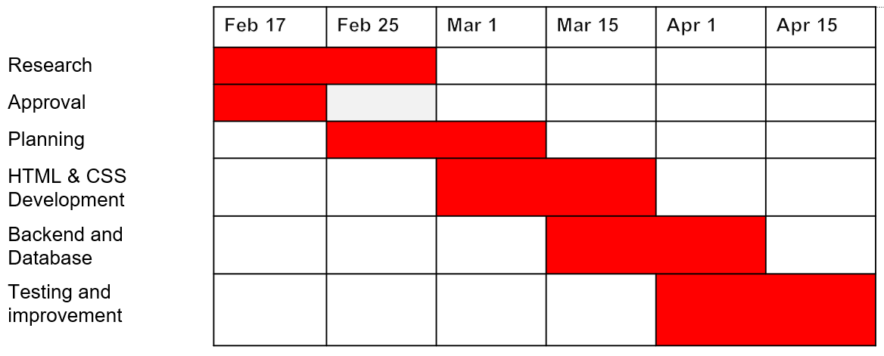
Gantt Chart
Radiant Games - Online Games Store

Slide 6
References
https://screenrant.com/best-websites-tracking-video-game-sales-deals/
https://store.epicgames.com/en-US/
https://www.gamestheshop.com/
https://www.w3schools.com/
https://www.geeksforgeeks.org/html/
Radiant Games - Online Games Store

Slide 7
Thank You

